Slide 1
Meeting for decision-making
What can we learn about an assembly or group by looking at how they meet to make decisions?
How are decisions made in different types of governments and groups?
Is there a right or wrong way to make decisions?

Slide 2
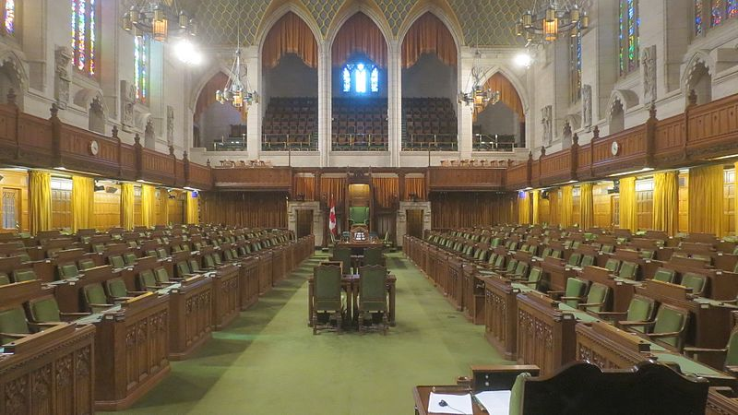
Photo: Bob Lindsell https://www.panoramio.com/photo/93935827
Notes:
Canadian House of Commons, Parliament Ottawa - What do you see in this photo? What kinds of decisions might be made here? Who do you think sits where? What questions does this photo make you think of? (ex from other students: Who sits in the big chair at the back? Is there assigned seating? How do you get to the balcony?)

Slide 3
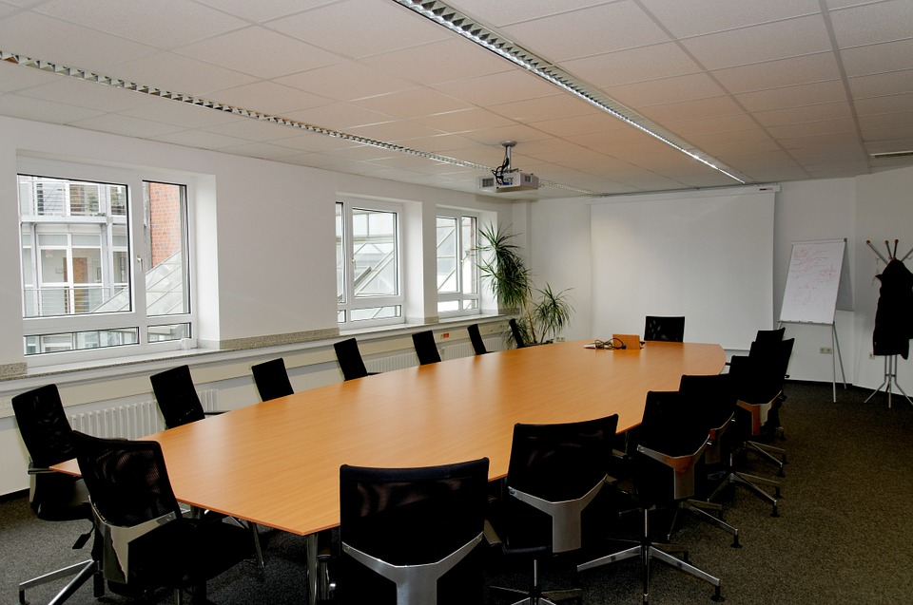
Source: pixabay
Notes:
Typical conference room - Who might make decisions in a space like this? How is it the same and different from the fist picture? What questions or connections does this photo make you think of (ex from other students: Do certain people use it all the time? How come only one person get a computer? People are facing each other but close together.

Slide 4
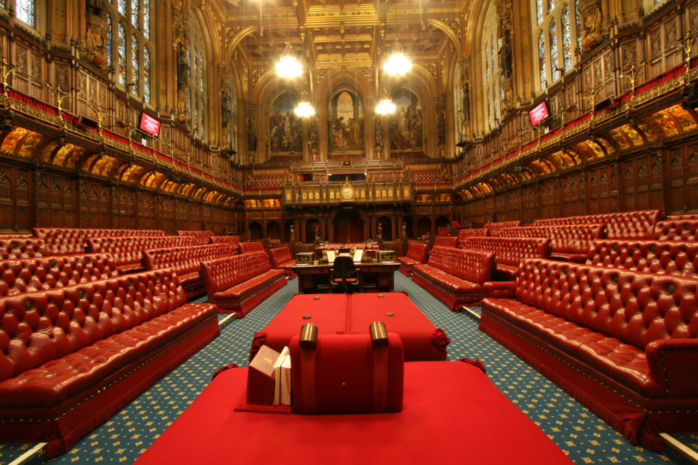
Source: UK Parliament Flickr (Creative Commons)
Notes:
House of Lords - London UK - the “upper house” of the British Parliament- What kinds of decision might be made here? Who do you think does the most talking? What questions come to mind (ex from other students: who gets to sit in the front? Is there a boss? Where do they sit? Is this in a church? Do you have to be quiet?)

Slide 5
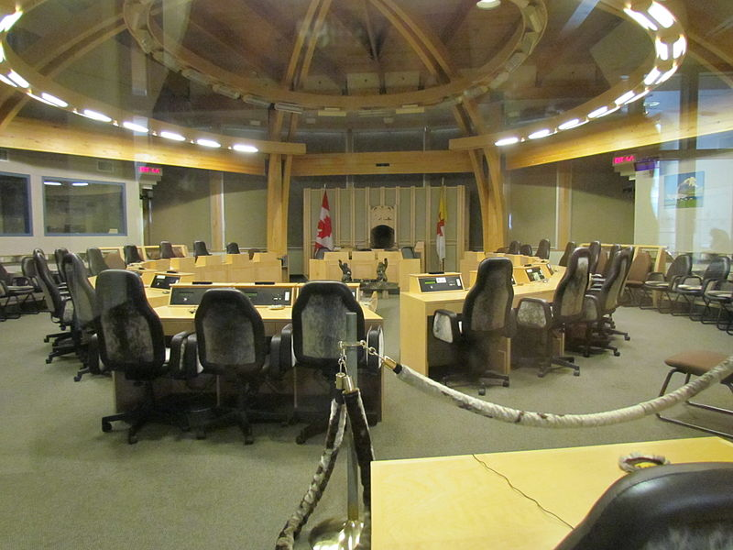
source:ADialla Flickr: (wikimedia commons)
Notes:
Legislative Assembly of Nunavut - How does this image differ than the first one? What kinds of questions does it make you think of (ex from other students: It looks more comfortable, Can all the people hear each other? What are the chairs made of?

Slide 6
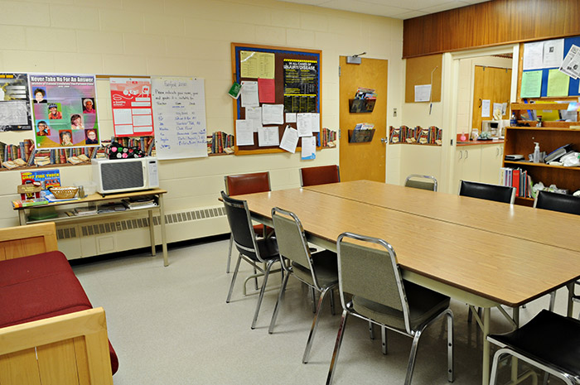
Source: useourschools.ca
Notes:
Teachers room at South Perch Centennial Public School- What types of decisions might be made here? What connections or questions does it make you think of? (ex from other students: Are the chairs uncomfortable? I think people eat here too. Can you be noisy in here?

Slide 7
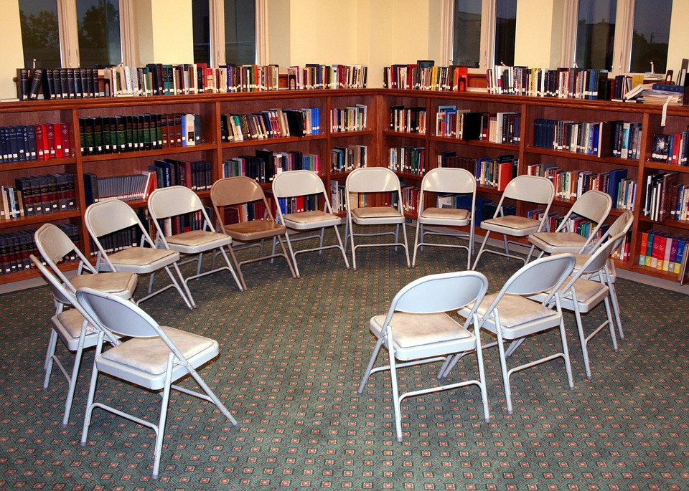
Source: pixabay
Notes:
A typical library meeting space-

Slide 8
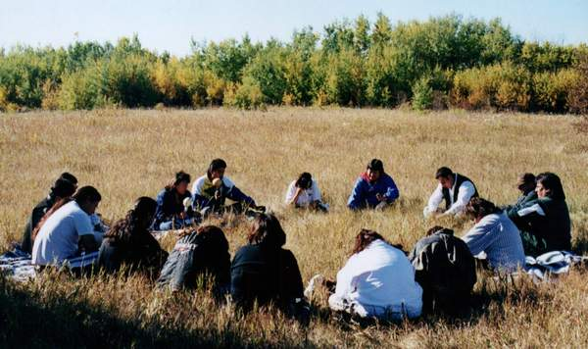
Source: University nuhelot’įne thaiyots’į nistameyimâkanak Blue Quills
Notes:
Diverse Sharing Circle - University Blue Quills, Alberta- How is this meeting space different than some of the others? How is it the same? Is anyone “in charge”? What kinds of decisions might be made here? Can you think of questions or connections in relation to this picture? (ex from other students: Why isn’t there any furniture? If you make a decision outside, does it count? Can we go outside?

Slide 9
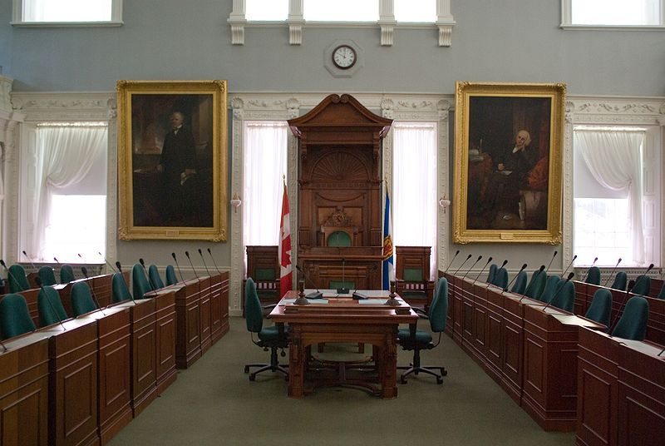
Source: CPHofmann (creative commons)
Notes:
Nova Scotia House of Assembly- Halifax, Province House - Do you see anything in the photo that you recognize? What does it remind you of? (ex from other students: It looks like the other green picture but smaller. Why do some have a big desk? Why do they have microphones if they are so close together?

Slide 10
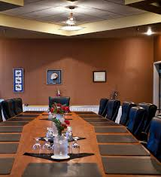
Notes:
Band Council Chamber - Membertou First Nation - How is this similar to other meeting spaces? How well can people hear one another? (examples from students: it looks like an office, it looks formal but comfy)

